Slide 1
PROJECT TITLE & TEAM
Flood – Detection ,preparedness and relief.
Team Members:
A.Md .Shaesta,3rd ECE,
P.Maheen,3rd ECE,
P.Naheen ,3rd ECE.
GATES Institute Of Technology.

Slide 2
PROBLEM STATEMENT
Floods are one of the most frequent and severe natural disaster.
One can predict the natural disasters but nobody can stop them.
Damages from flooding:
Loss of life .
Injury.
Inability to earn.
Hunger.
Increase of water brone diseases.

Slide 3
SOLUTION
Here our project includes detection, preparedness and relief methods.
DETECTION PROCESS :
Here we are going to detect floods by using sensors.
PREPAREDNESS:
Sending alert voice message through drones.
Providing life jackets .
RELIEF:
Providing food and water.
Helping humans by providing ropes.
Sending alert message or call to rescue team.

Slide 4
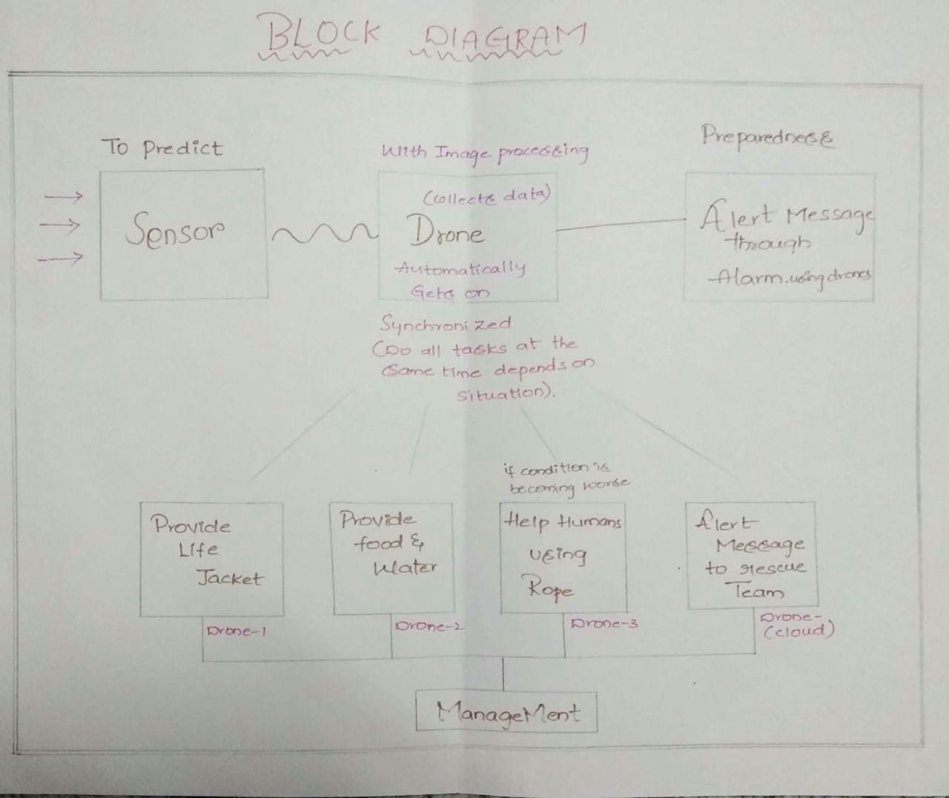
PROTOTYPE BLOCK DIAGRAM

Slide 5
TECHNOLOGY STACK
SOFTWARE
HARDWARE
IBM Cloud
Node red
MIT app inventor
IFTTT
TWILIO
nodeMCU esp8266
Dht 11 sensor
Rain sensor
Raspberry pi
Pi cam

Slide 6
CHALLENGES
Detection by using machine learning.
Image processing or visual recognition to identify objects and peoples.
Voice message alert using voice agent and twilio.
Sending email and SMS using IFTTT.
Voice call using IFTTT.
Mobile app to get data for humidity, temperature and rain value including SMS.

Slide 7
CONTACT US
Name: Alisher Mohammed Shaesta.
Mobile No: 8466924339
Email ID: alishershaesta@gmail.com
Name: P Maheen
Mobile No: 7799577586
Email ID: maheen.panikatlla@gmail.com
Name: P Naheen
Mobile No: 7673981954
Email ID: naheen.panikatlla@gmail.com

